Slide 1
Tableau Capstone Project
Airbnb Property

Slide 2


Data Source
Dataset taken into consideration is obtained from Kaggle.
The dataset used for analysis contains data on Airbnb Property in
U.S.(2011-2016)

Slide 3
Problem Statement
Average Price Based on Zip code each Region and states.
Top Regions Based On Ratings.
Top Regions Based on Availability of Beds and shared each Room type.
Average Prices Fluctuated as per Years.
Property Available in Neighborhood.
Beds Availability and Avg Prices over the years.
Top 10 Property types.

Slide 4
Summary
This Data set contains the insights of sales in each country and states of Europe
The data consists of Host ID, Year, Neighbourhood, Property type, Room type, Zip code, Beds, Ratings etc.
Data set is having 30476 rows and 12 columns.
It Contains information by Region, Bed Availability, Property type, Room type , categories and other categories
By Analysing the Data we will get the clear view of Final Outcomes
Video Link- https://drive.google.com/file/d/1K4_reKHKQmdmBvmayxDo2AQB-gI1tz6V/view?usp=sharing

Slide 5
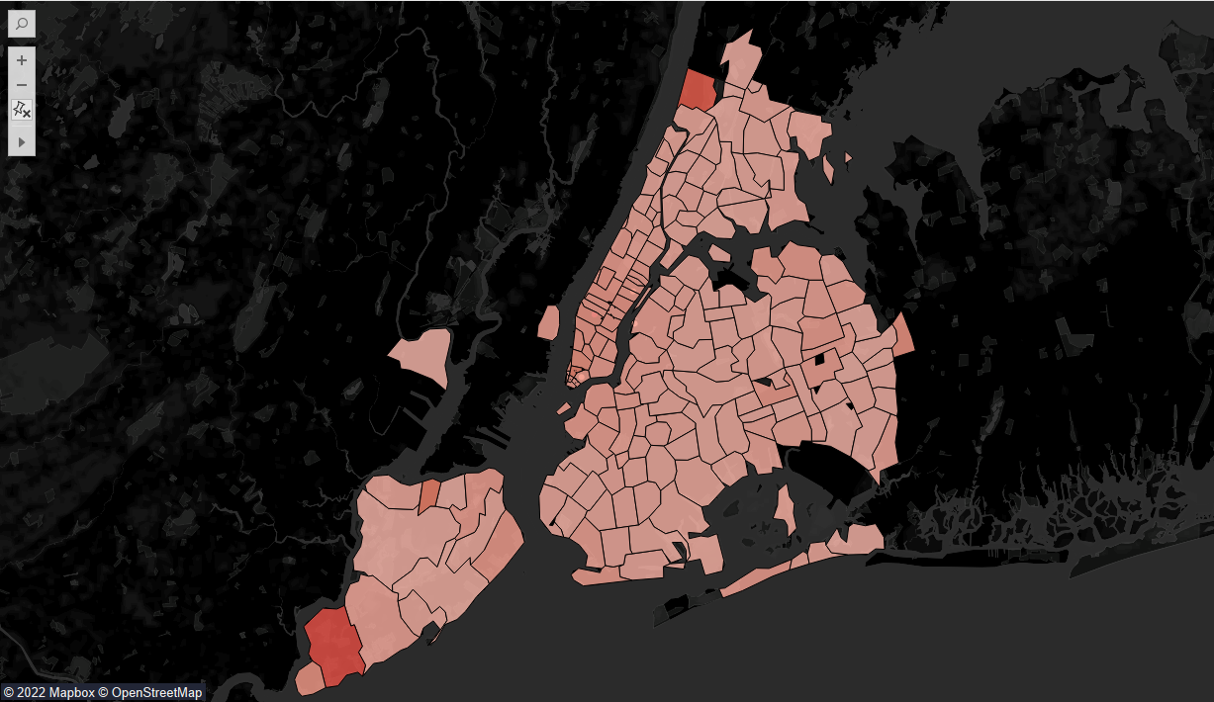
Avg. Price Based on Zip code

Slide 6
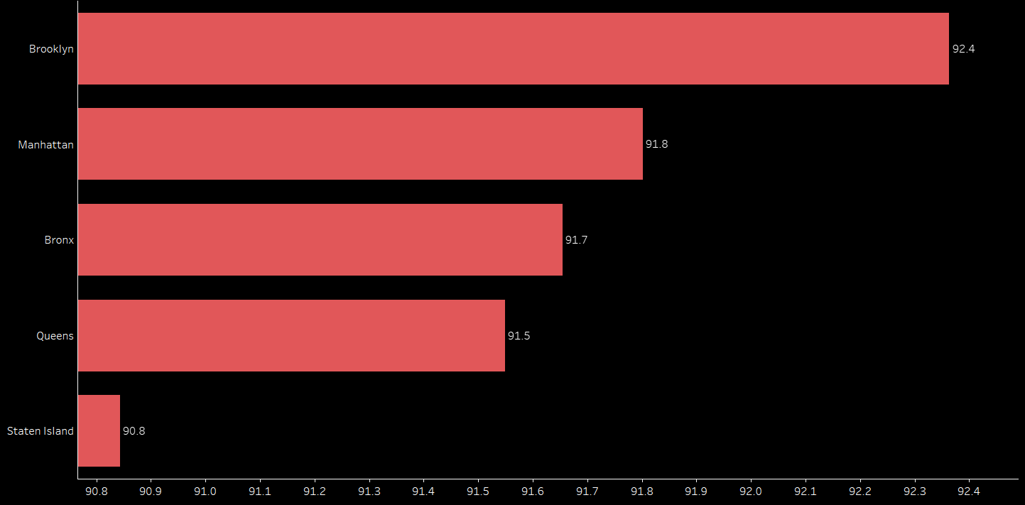
Top Region Rating Wise

Slide 7
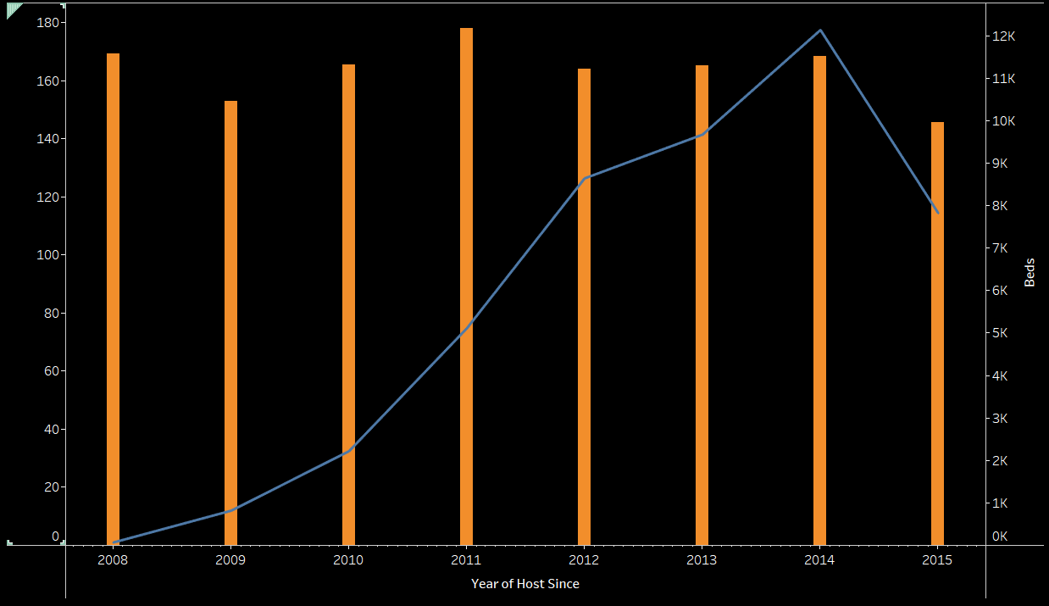
Bed Availability and Avg. Price over the Years

Slide 8
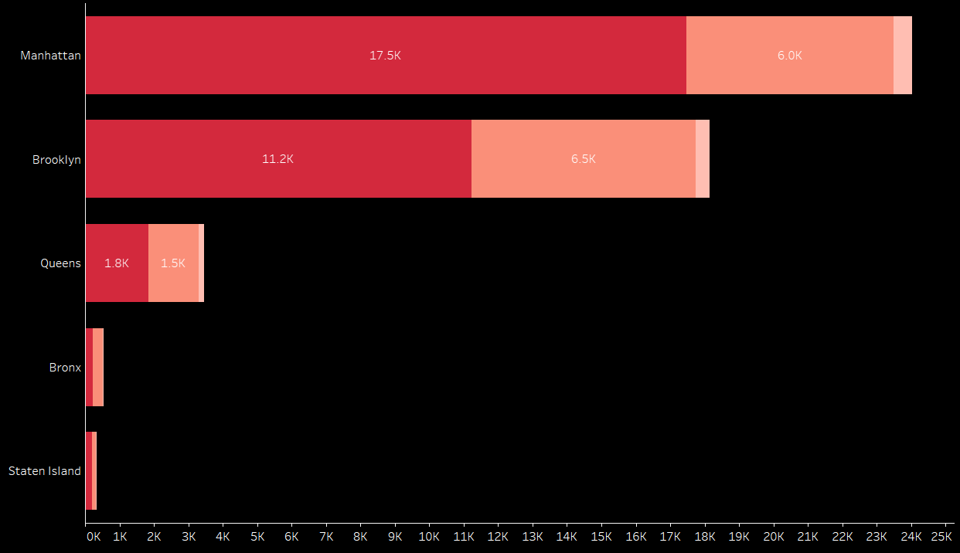
Top Regions (Bed Availability)

Slide 9
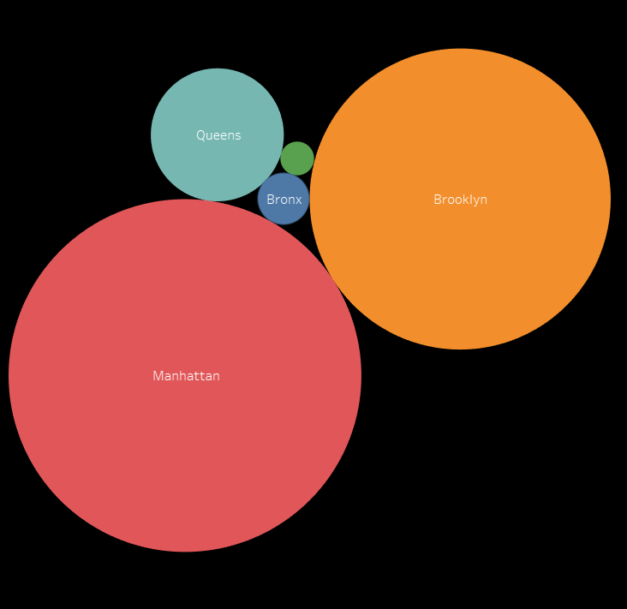
Property Availability in Neighbourhood

Slide 10
Conclusion
After analyzing the dataset here by I conclude
In the Rating categories Brooklyn have the highest Avg. Rating of 92.4
Over the Years Availability of Beds are Significantly Increasing
Among the Cities Manhattan has the highest Beds Available in Entire Home/Apartment Type.
Top 5 Property Types are Villa, Condominium, Loft, Townhouse.

